Slide 1
Capstone Project 3
Mobile Price Range Prediction
Individual project-
Name-Harshad Savle
Email-harshad.savle@gmail.com

Slide 2
Contents
Problem Statement
Understanding dataset
Exploratory data analysis
Heat map
Machine learning algorithms
Logistic regression
Decision tree
Random forest classifier
Xgboost classifier
conclusion

Slide 3
Problem statement
In the competitive mobile phone market companies wantto understand sales data of mobile phones and factors which drive the prices.
The objective is to find out some relation between features of a mobile phone(eg:- RAM,Internal Memory etc.) and its selling price. In this problem, we do not have to predict theactual price but a price range indicating how high the price is.

Slide 4

Understanding the dataset
Data Description
The data contains information regarding mobile phone features, specifications etc and their price range. The various features and information can be used to predict the price range of a mobile phone.
Battery_power - Total energy a battery can store in one time measured in mAh
Blue - Has bluetooth or not
Clock_speed - speed at which microprocessor executes instructions
Dual_sim - Has dual sim support or not
Fc - Front Camera mega pixels
Four_g - Has 4G or not
Int_memory - Internal Memory in Gigabytes
M_dep - Mobile Depth in cm
Mobile_wt - Weight of mobile phone

Slide 5
Data description(cont.)
N_cores - Number of cores of processor
Pc - Primary Camera mega pixels
Px_height - Pixel Resolution Height
Px_width - Pixel Resolution Width
Ram - Random Access Memory in Mega Bytes
Sc_h - Screen Height of mobile in cm
Sc_w - Screen Width of mobile in cm
Talk_time - longest time that a single battery charge will last when you are
Three_g - Has 3G or not
Touch_screen - Has touch screen or not
Wifi - Has wifi or not
Price_range - This is the target variable with value of 0(low cost), 1(medium cost), 2(high cost) and 3(very high cost).

Slide 6
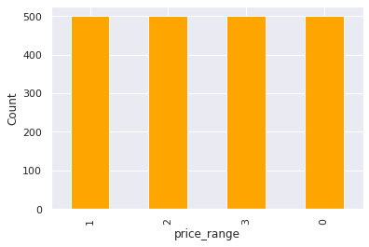
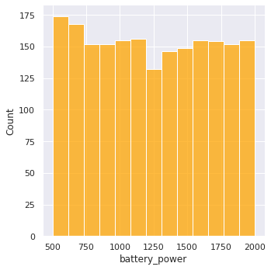
Price
Battery
there are mobile phones in 4 price ranges. the number of elements is almost similar
this plot shows how the battery mAh is spread. there is a gradual increase as the price range increases

Slide 7
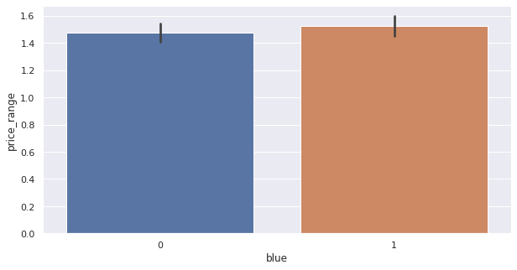
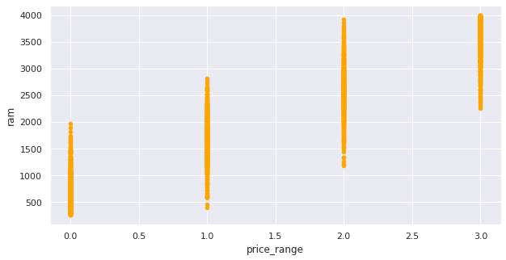
bluetooth
RAM
half the devices have Bluetooth, and half don’t
Ram has continuous increase with price range while moving from Low cost to Very high cost

Slide 8
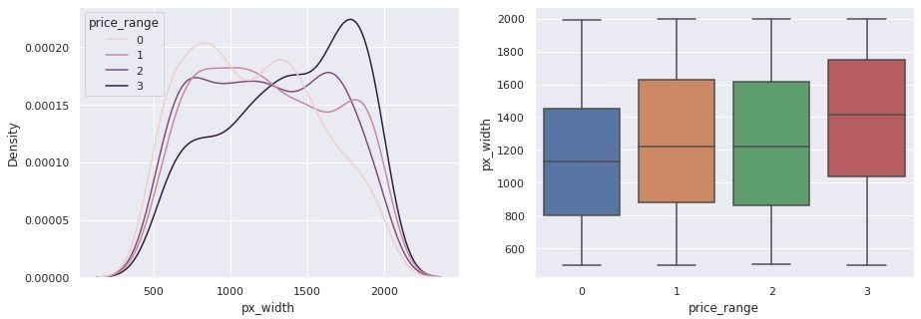
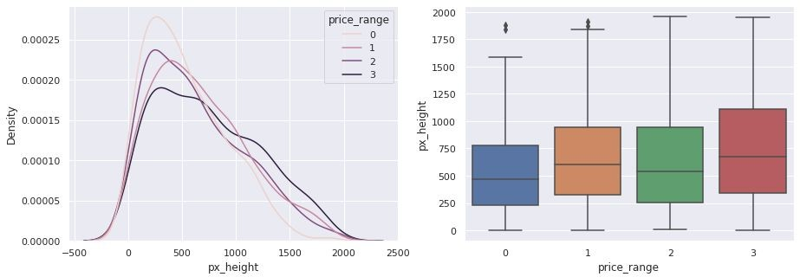
Px_width
px_height
There is not a continuous increase in pixel width as we move from Low cost to Very high cost. Mobiles with 'Medium cost' and 'High cost' has almost equal pixel width. so we can say that it would be a driving factor in deciding price_range.
Pixel height is almost similar as we move from Low cost to Very high cost.little variation in pixel_height

Slide 9
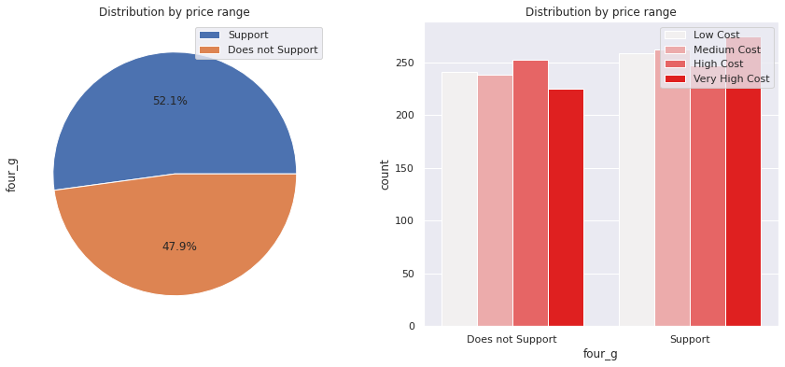
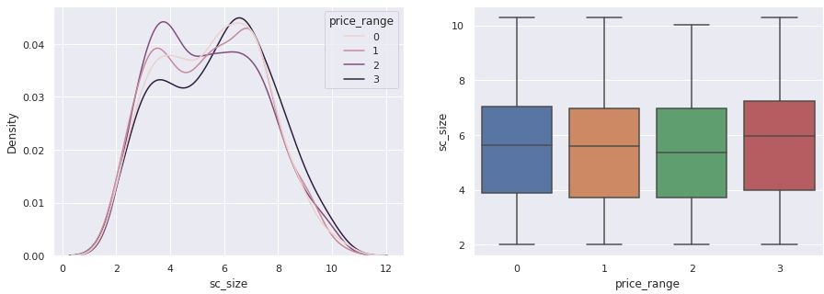
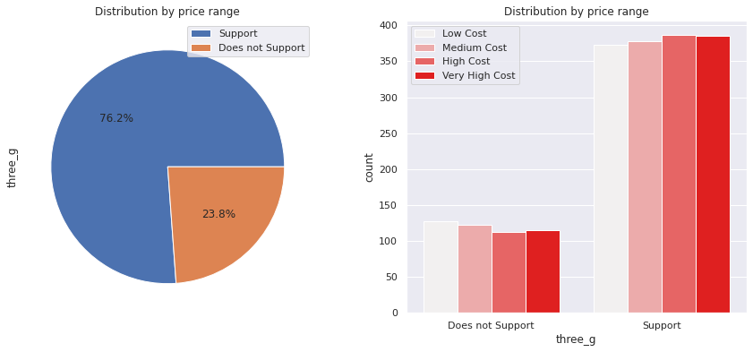
4g and 3g
screen_size
Combining the sc_height and sc_width into one column that is sc_size, Screen Size shows little variation along the target variables. This can be helpful in predicting the target categories.
50% of the phones support 4_g and 76% of phones support 3_g,feature 'three_g' play an important feature in prediction.

Slide 10
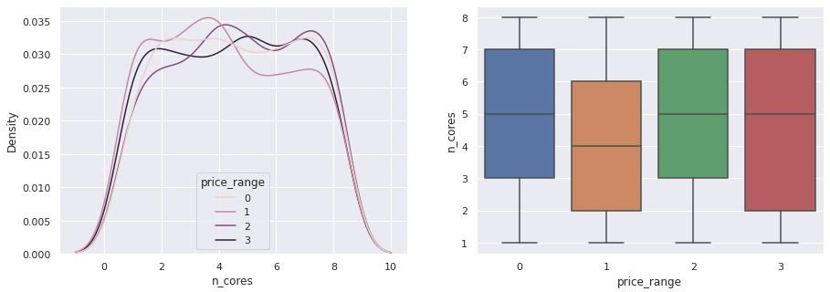
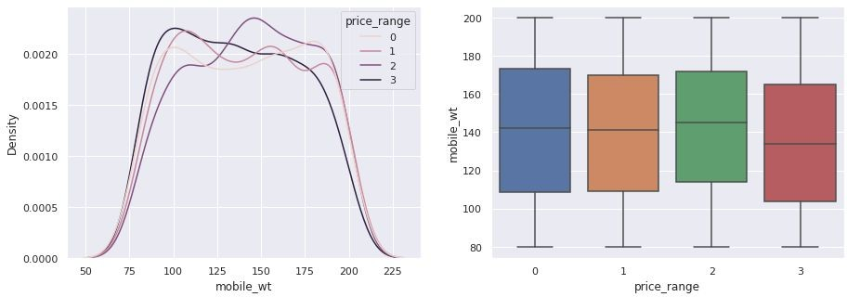
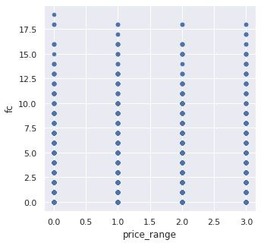
FC (front camera megapixels)
PC (Primary camera Megapixels )
mobile weight
This features distribution is almost similar along all the price ranges variable, it may not be helpful in making predictions
Primary camera megapixels are showing a little variation along the target categories, which is a good sign for prediction.
costly phones are lighter

Slide 11
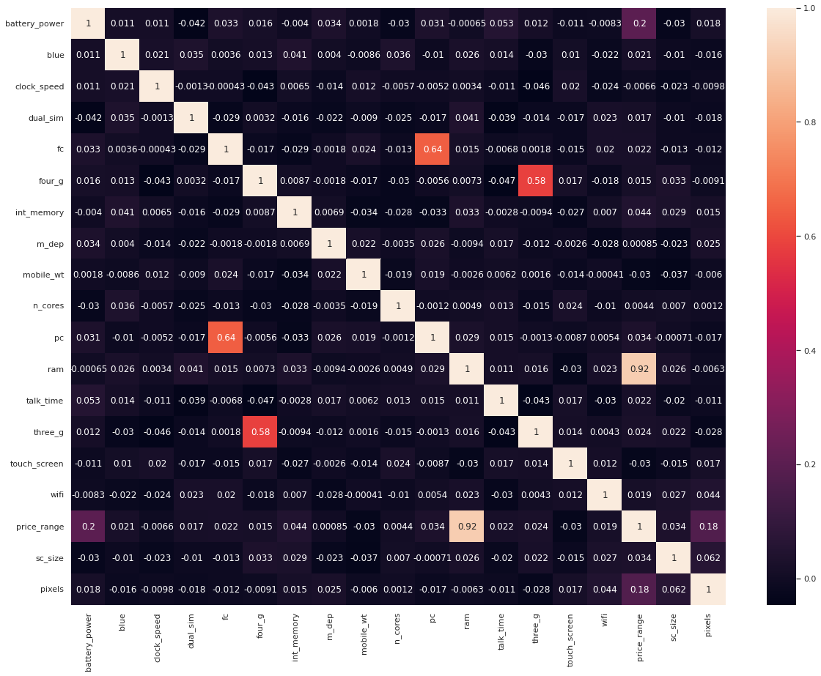
Heat map
RAM and price_range shows high correlation which is a good sign, it signiﬁes that RAM will play major deciding factor in estimating the price range.
There is some collinearity in feature pairs ('pc', 'fc') and ('px_width', 'px_height'). Both correlations are justiﬁed since there are good chances that if front camera of a phone is good, the back camera would also be good.
Also, if px_height increases, pixel width also increases, that means the overall pixels in the screen. We can replace these two features with one feature. Front Camera megapixels and Primary camera megapixels are different entities despite of showing colinearity. So we'll be keeping them as they are.

Slide 12
ML algorithms
Logistic regression
Decision tree
Random Forest classification
XGboost

Slide 13
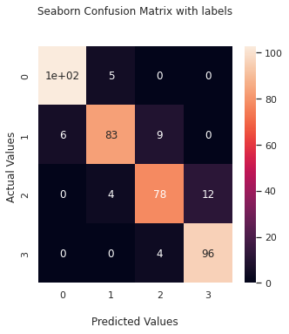
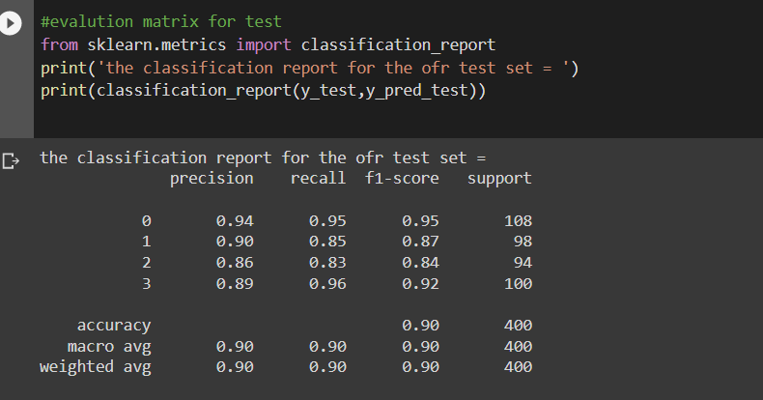
Logistic regression
Test_accuracy: 90%

Slide 14
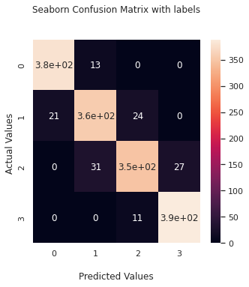
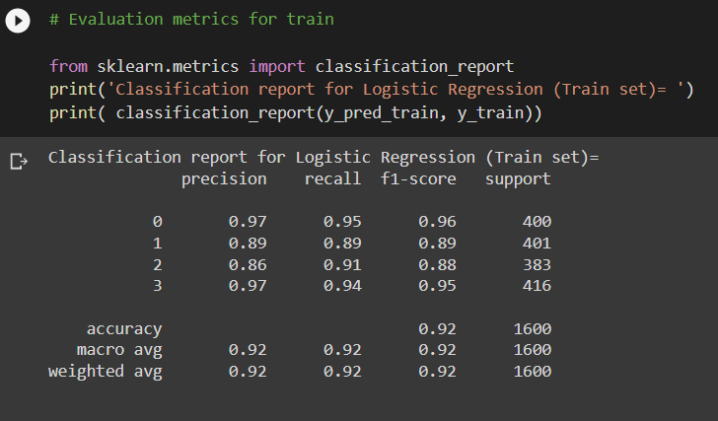
Train_accuracy : 92%

Slide 15
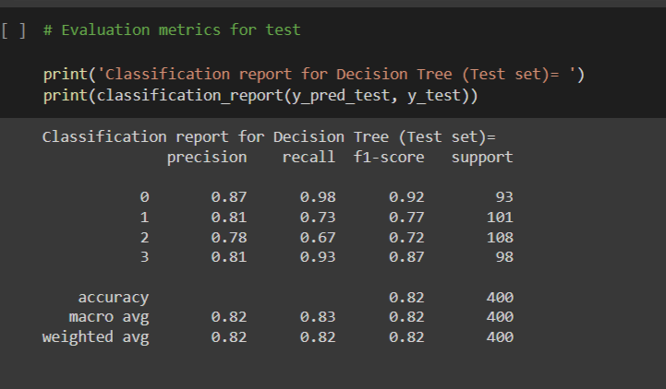
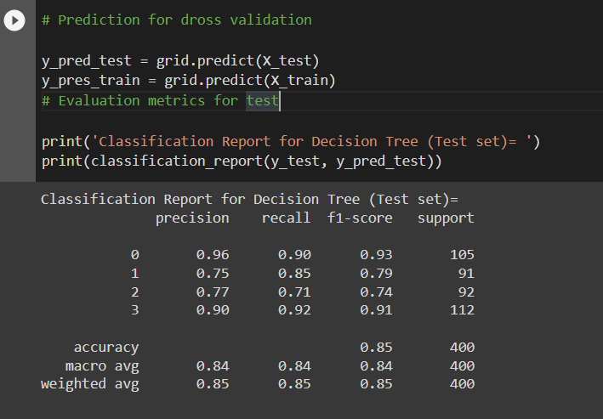
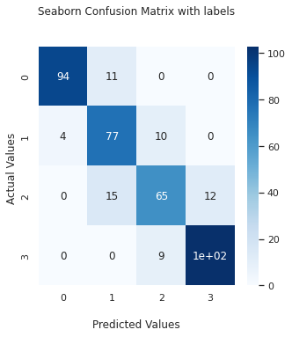
Decision tree with hyperparameter tuning
Decision tree
Test_accuracy : 82%
Test_accuracy : 85%

Slide 16
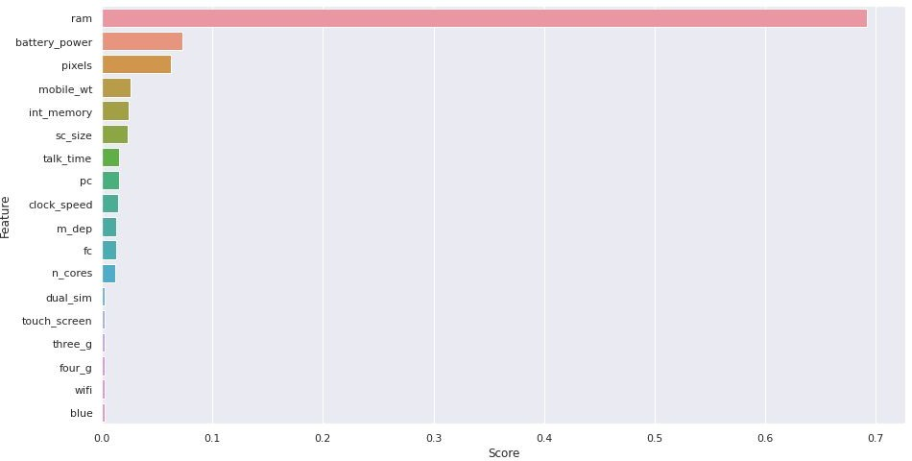
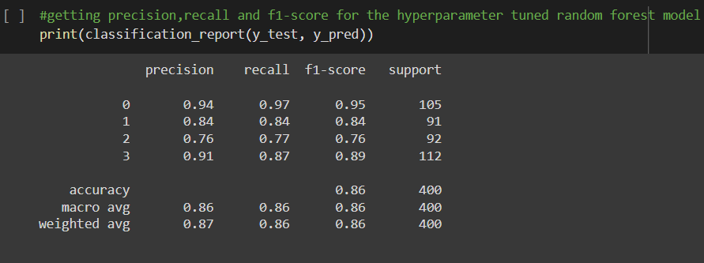
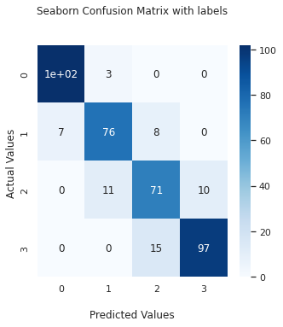
Random forest classiﬁer with hyper parameter tuning
Train_accuracy : 86%
As we can see the top 3 important features of our dataset are: RAM, battery_power ,pixels

Slide 17
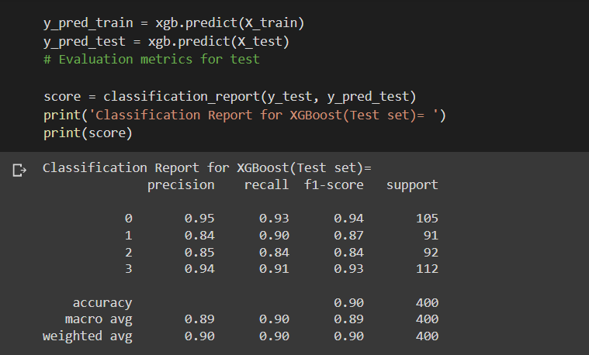
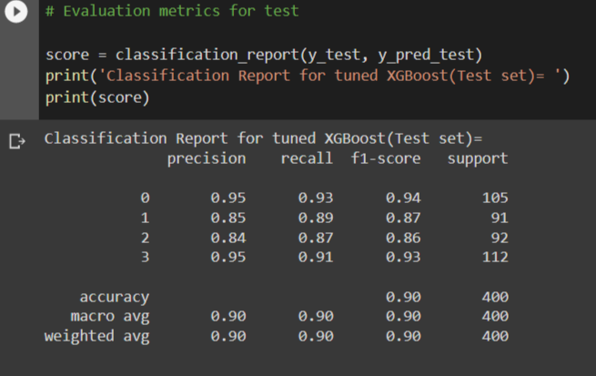
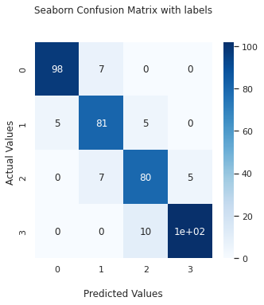
XGboost with hyperparameter tuning
XGboost
Test_accuracy : 89%
Test_accuracy : 90%

Slide 18
conclusion
From EDA we can see that here are mobile phones in 4 price ranges. The number of elements is almost similar.
half the devices have Bluetooth, and half don’t
there is a gradual increase in battery as the price range increases
Ram has continuous increase with price range while moving from Low cost to Very high cost
costly phones are lighter
RAM, battery power, pixels played more significant role in deciding the price range of mobile phone.
form all the above experiments we can conclude that logistic regression and, XGboosting with using hyperparameters we got the best results
The accuracy and performance of the model is evaluated by using confusion matrix

